Slide 1
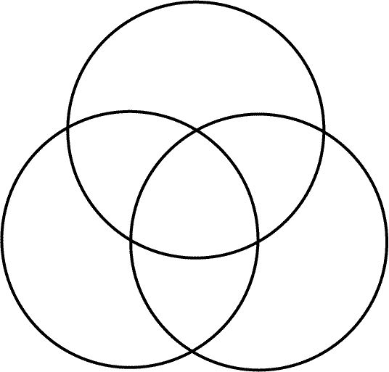
Data-frame
Definition: used for storing data tables. It is a list of vectors of equal length. In panda, a Data-Frame is a 2-dimensional labeled data structure with columns of potentially different types, usually seen as spreadsheets or SQL tables.
List of dictionaries, key, data storage & changes
List
vectors
Dictionary
All store data
Definition: or sequence is
an abstract data type that
represents a countable number
of ordered values, where the same value may occur more than once.
it accepts similar data type values at a time and is ideal for linear collections
not accessed by keys.
Definition: are built into python and sometimes found in other languages as “associative memories” or “associative
arrays”; dictionaries are indexed by keys,
which can be any immutable type.
strings and numbers can always be keys.
it accepts different data types
at a time and is composed of
separate keys and values
Both accept data types at a time.
→ Commas & Index

